Slide 1
Initial Assessment of Benefits and Costs of Connected and Automated Vehicles (CAVs) in Texas
Study Objective
  First-order assessment of CAVs’ impact in Texas
  Potential for enhancing mobility, safety, productivity & leisure
Methodology
  Estimate new VMT (AV capabilities, congestion rebound, vehicle ownership change)
  Estimate mobility change (CACC)
  Estimate safety change (categorize & apply CRFs)
  Estimate productivity & leisure benefit (25% of VOTT)

Slide 2
Initial Assessment of Benefits and Costs of Connected and Automated Vehicles (CAVs) in Texas
Results
Conclusions
  Even with rising VMT, congestion should be fall overall
  Much of these benefits are not just for CAV owners, but
  to society as a whole, as other road users benefit from
  reduced congestion and crash risk
Market Penetration |  | 10% | 50% | 90%
Benefit | Congestion reduction ($/CAV/Year) | $32 | $79 | $209
 | Comprehensive Savings ($/CAV/Year) | $175 | $1,234 | $2,615
 | Productivity and Leisure ($/CAV/Year) | $1,246 | $1,246 | $1,246
 | Sum of benefits ($/CAV/Year) | $1,453 | $2,559 | $4,070
Cost | Price cost for automation and connectivity capabilities ($/CAV) | $10,000 | $5,000 | $3,000
Net Present Value |  | $1,368 | $15,022 | $28,846
B/C |  | 1.1 | 4.0 | 10.6

Slide 3
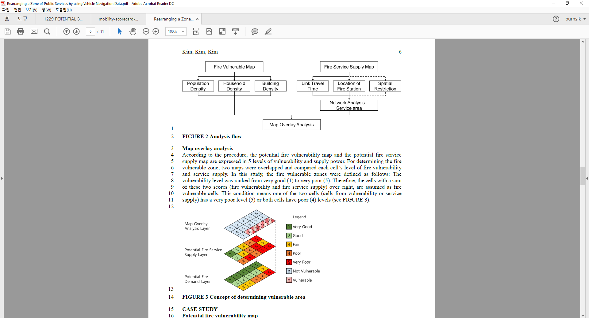
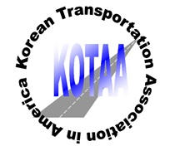
Rearranging a Zone of Public Services by using Vehicle Navigation Data
Study Objective
  Minimize fire service response time using real observed car navigation data
  Integrate service zones
Methodology
  10m X 10m cells (6 million cells), map overlay analysis

Slide 4
Rearranging a Zone of Public Services by using Vehicle Navigation Data
Results
Conclusions
  Fire vulnerable area in Seoul decrease from 9.1% to 5.3% while the service zones integrated
  Jung-Gu (11.8% → 0%), Songpa-Gu(22.8%→19.2%),
  Gangnam-Gu(19.8%→ 16.0%)

